Slide 1


Modern Operating Systems
Fifth Edition
Chapter 2
Processes
Copyright © 2023, 2014, 2008 Pearson Education, Inc. All Rights Reserved
Notes:
If this PowerPoint presentation contains mathematical equations, you may need to check that your computer has the following installed:
1) Math Type Plugin
2) Math Player (free versions available)
3) NVDA Reader (free versions available)

Slide 2
The Process Model
Process = Program in execution
How many processes for each program?
A fundamental operating system abstraction
Allows the O S to simplify:
Resource allocation
Resource accounting
Resource limiting
O S maintains information on the resources and the internal state of every single process in the system

Slide 3
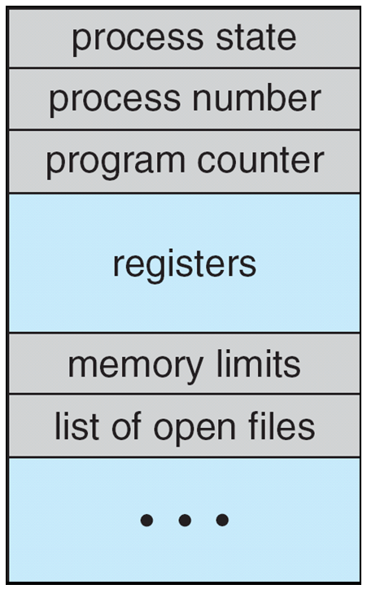
The Process Model
Information associated with each process (process control block)
Process state – running, waiting, etc
Program counter – location of instruction to next execute
CPU registers – contents of all process-centric registers
CPU scheduling information- priorities, scheduling queue pointers
Memory-management information – memory allocated to the process
Accounting information – CPU used, clock time elapsed since start, time limits
I/O status information – I/O devices allocated to process, list of open files

Slide 4
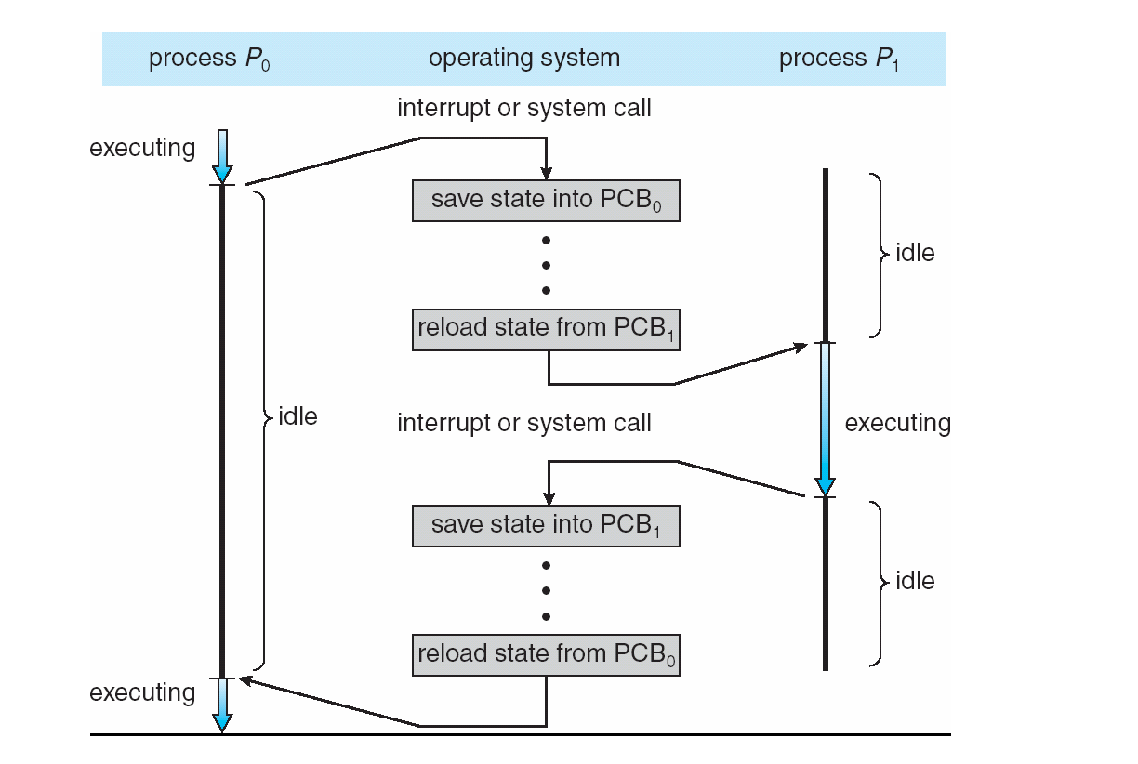
CPU Switch From Process to Process

Slide 5
Context Switch
When CPU switches to another process, the system must save the state of the old process and load the saved state for the new process via a context switch
Context of a process represented in the PCB
Context-switch time is overhead; the system does no useful work while switching
The more complex the OS and the PCB ➔ the longer the context switch
Time dependent on hardware support
Some hardware provides multiple sets of registers per CPU ➔ multiple contexts loaded at once

Slide 6
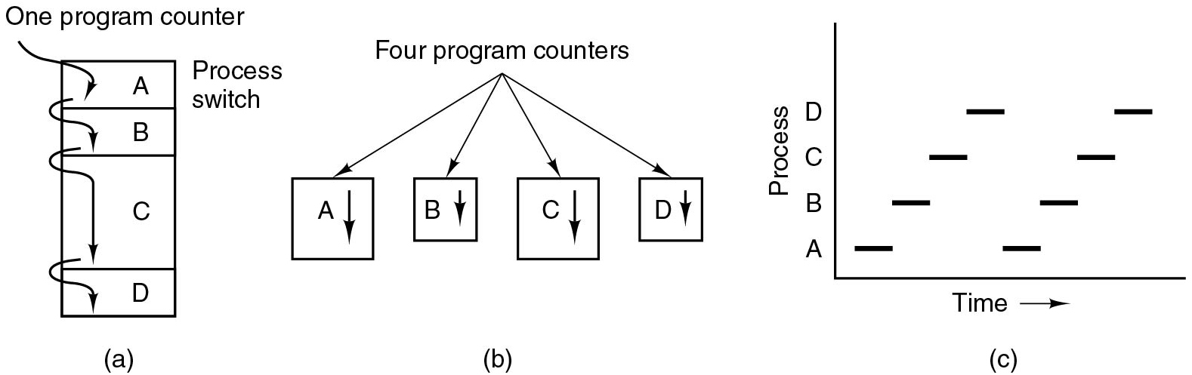
The Process Model
Each process has own flow of control (own logical program counter)
Each time we switch processes, we save the program counter of first process and restore the program counter of the second
(b) Conceptual model of four independent, sequential processes.

Slide 7
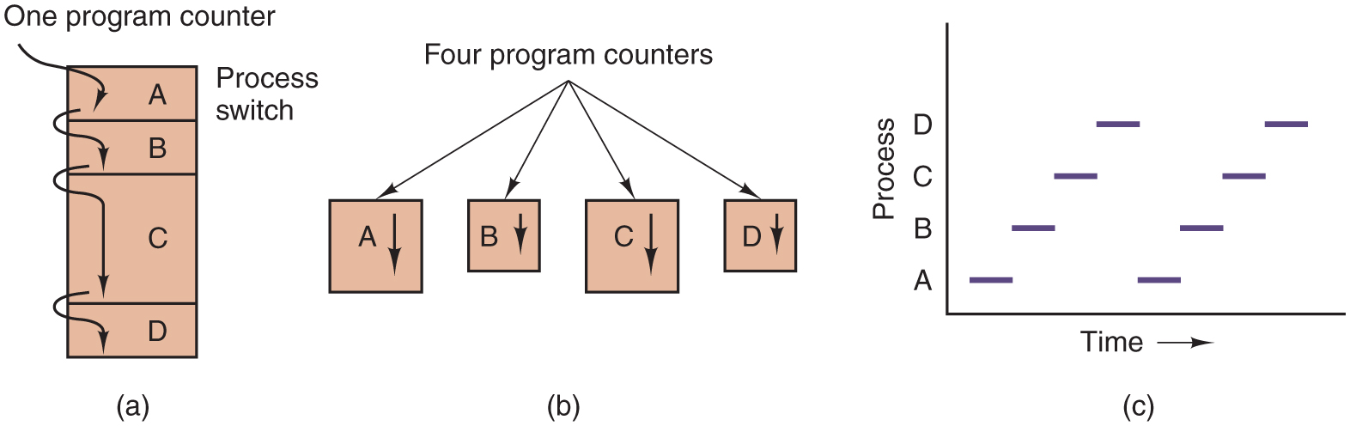
Concurrent Processes
So far, process has a single thread of execution
Consider having multiple program counters per process
Multiple locations can execute at once
Multiple threads of control -> threads

Slide 8
Process Hierarchies
O S typically creates only 1 init process
Subprocesses created independently:
A parent process can create a child process
This results in a tree-like structure and process groups

Slide 9
Process Creation
Four principal events that cause processes to be created:
System initialization
Execution of a process creation system call by a running process
A user request to create a new process
Initiation of a batch job

Slide 10
Process Termination
Typical conditions which terminate a process:
Normal exit (voluntary).
Error exit (voluntary).
Fatal error (involuntary).
Killed by another process (involuntary).
The parent process may wait for termination of a child process by using the wait()system call. The call returns status information and the pid of the terminated process
pid = wait(&status);
If no parent waiting (did not invoke wait()) process is a zombie
If parent terminated without invoking wait , process is an orphan

Slide 11
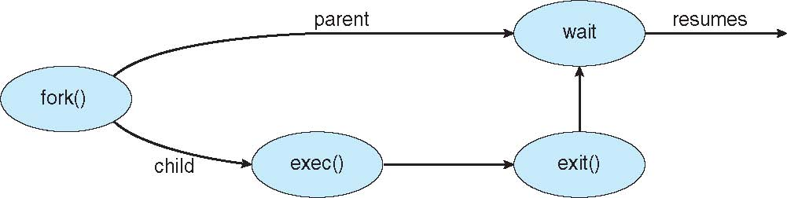
Process Management
fork: create a new process
Child is a “private” clone of the parent
Shares some resources with the parent
exec: execute a new process image
Used in combination with fork
exec on Windows?
exit: cause voluntary process termination
Exit status returned to the parent
Involuntary process termination?
kill: send a signal to a process (or group)
Can cause involuntary process termination

Slide 12
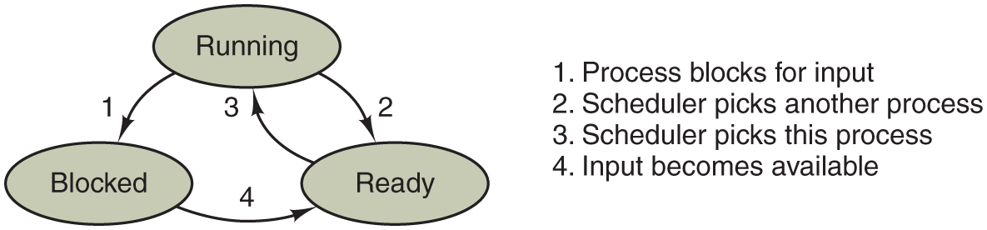
Process States
A process can be in running, blocked, or ready state. Transitions between these states are as shown.
A process can be in running, blocked, or ready state. Transitions between these states are as shown.
Notes:
Long Description:
Transitions between the three states are as shown. There are three oval-shaped blocks labeled Running, Blocked, and Ready. The Running block is placed on top while the other two blocks are placed at the lower left and lower right. There are two downward arrows from running: an arrow labeled 1 points to Blocked and the other arrow labeled 2 points to Ready. An arrow labeled 3 from Ready points to Running block. An arrow labeled 4 from Blocked points to Ready. The description of arrows is mentioned on the right side of the diagram: 1. Process blocks for input. 2. Scheduler picks another process. 3. Scheduler picks this process. 4. Input becomes available.

Slide 13
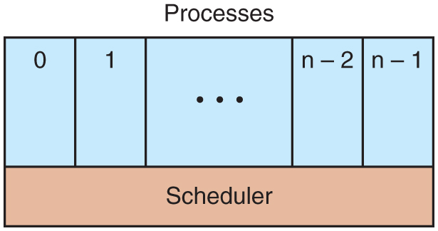
Process States
Scheduler periodically switches processes
Sequential processes lay on the layer above
This leads to a simple process organization
The lowest layer of a process-structured operating system handles interrupts and scheduling. Above that layer are sequential processes.
Notes:
Long Description:
There is a rectangular block labeled Processes with five vertical partitions and one horizontal partition. The first vertical partition is labeled 0, the second is labeled 1, the third is labeled so on depicted by three dots, the fourth is labeled n minus 2 and the fifth is labeled n minus 1. The horizontal partition is labeled Scheduler.

Slide 14
Interrupts
Idea: to deallocate the C P U in favor of the scheduler, we rely on hardware-provided interrupt handling support
Allows the scheduler to periodically get control, i.e., whenever the hardware generates an interrupt
Interrupt vector:
Associated with each I/O device and interrupt line
Part of the interrupt descriptor table (I D T)
Contains the start address of an O S-provided internal procedure (interrupt handler)
The interrupt handler continues the execution
Interrupt types: sw, hw device (async), exceptions

Slide 15
Implementation of Processes
Overview of what the lowest level of the operating system does when an interrupt occurs.
Hardware stacks program counter, etc.
Hardware loads new program counter from interrupt vector.
Assembly language procedure saves registers.
Assembly language procedure sets up new stack.
C interrupt service runs (typically reads and buffers input).
Scheduler decides which process is to run next.
C procedure returns to the assembly code.
Assembly language procedure starts up new current process.
Every time an interrupt occurs, the scheduler gets control
acts as a mediator
A process cannot give the C P U to another process (context switch) without going through the scheduler

Slide 16
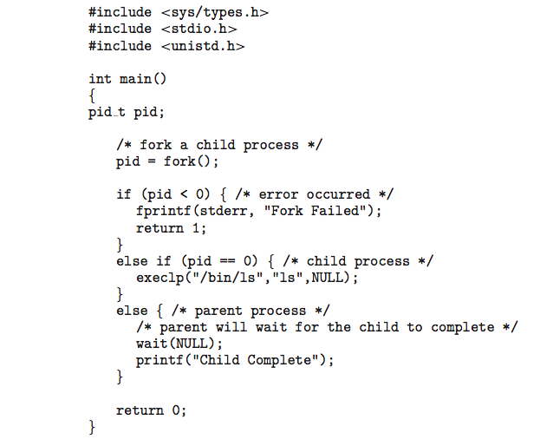
C Program Forking Separate Process

Slide 17
Modern Operating Systems
Fifth Edition
End of Processes
Copyright © 2023, 2014, 2008 Pearson Education, Inc. All Rights Reserved
Notes:
If this PowerPoint presentation contains mathematical equations, you may need to check that your computer has the following installed:
1) Math Type Plugin
2) Math Player (free versions available)
3) NVDA Reader (free versions available)

